Slide 1



CONCEPTUAL DESIGN PRESENTATION Devices Trying to Score in Each Others’ Goals
PITECH

Slide 2

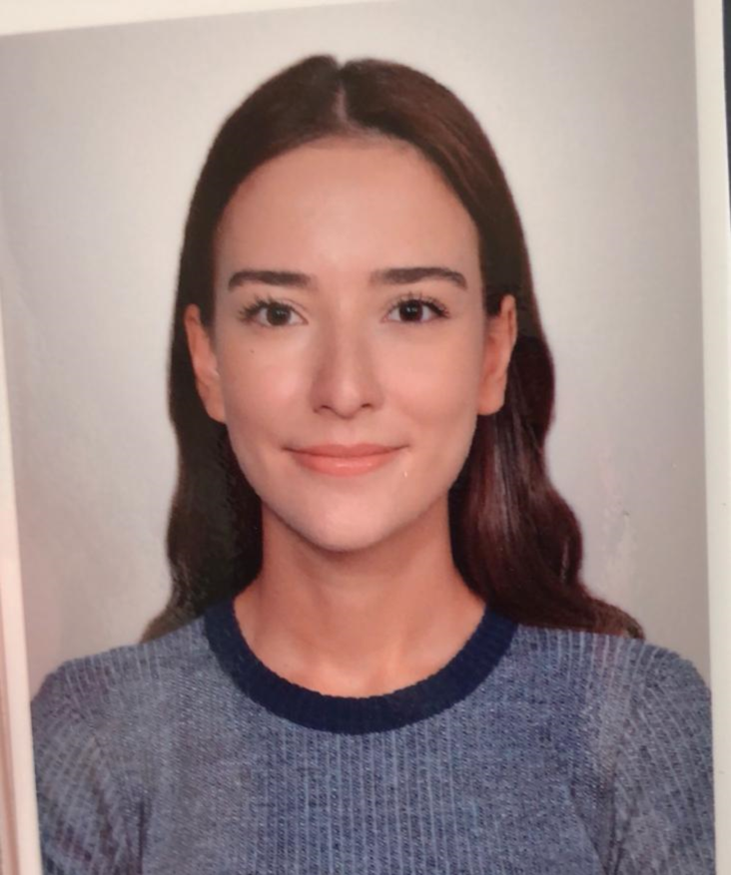
CEO FATMA NUR ARABACI
PITECH

Slide 3
Presentation Outline
01
04
Company Profile
Solution Approaches
02
05
Problem Statement
Plans
03
06
Requirements & Objectives
Conclusion
PITECH

Slide 4
COMPANY PROFILE Shareholders
FATOOOO GELCEK
COO İrem COŞKUN 2030419 | CMO Berkay GÖKSU 2030757 | CTO Furkan Bahadır ELİK 2030518 | CEO Fatma Nur ARABACI 2030047 | CFO Aycan BEYENİR 2030328
PITECH

Slide 5
COMPANY PROFILE Mission & Vision
Mission
To provide creative and reliable solutions that fulfill the needs of industry in the field of Industrial robot applications.
Vision
To become the most compelling technology company by driving the Industry’s transition to smart manufacturing.
PITECH

Slide 6
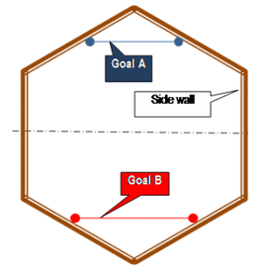
PROBLEM STATEMENT
Try to score in the opponents’ goal
Try to defend our own goal
Control via tele-controller (non-autonomous)
75 cm
PITECH

Slide 7
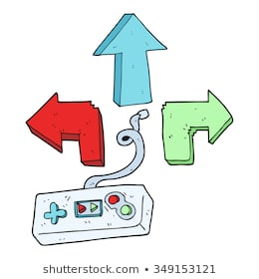
Oppenents’ Goal
Opponents’ Robot
The ball
Half Field Line
Our Goal
> 30 m
Controller Side
Our Robot
Playfield Side
PITECH

Slide 8
REQUIREMENTS & OBJECTIVES Requirements & Constraints
Oppenents’ Goal
Goal line should be two times of our robots’ diameter
20 sec Restriction
Robot should stay in its’ half field
Carrying, grasping and scooping the ball is not allowed.
Within $200 budget
Half Field Line
Our Goal
PITECH

Slide 9
REQUIREMENTS & OBJECTIVES Performance Related Objectives
Power Consumption
Transmission Delay
Range
Perfect–>more than 30m
Sufficient-> 30 m indoor
Poor/Failure-> less than 30 m
Perfect–> 30 min of operation
Sufficient -> 15 min of operation
Poor -> 5 min of operation
Perfect–> 100 ms delay
Good -> 400 ms delay
Sufficient-> 600 ms delay
Poor-> 1 sec delay
PITECH

Slide 10
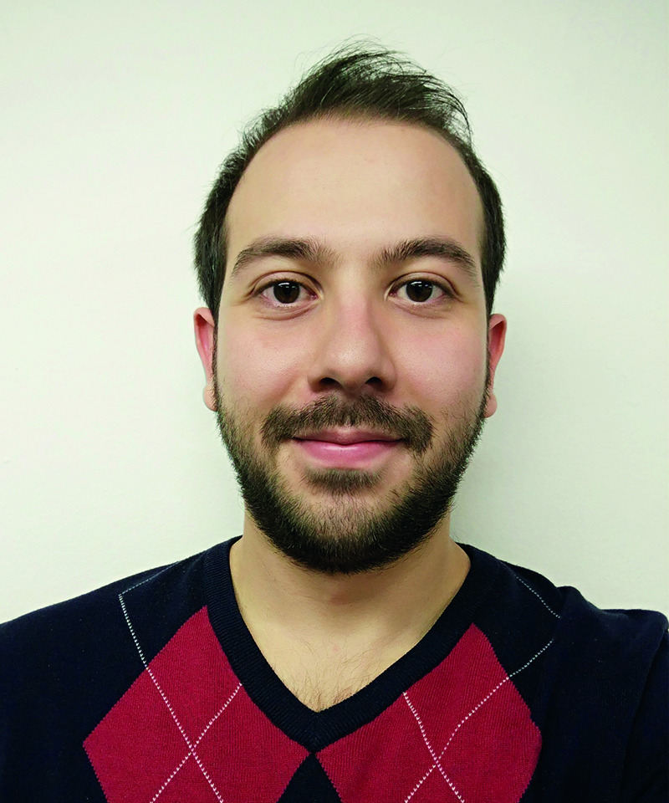
CMO BERKAY GÖKSU
PITECH

Slide 11
PITECH

Slide 12
PITECH

Slide 13
PITECH

Slide 14
PITECH

Slide 15
PITECH

Slide 16
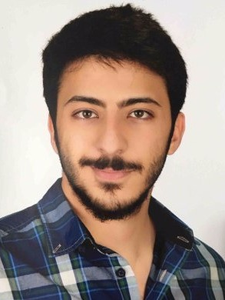
CTO FURKAN BAHADIR ELİK
PITECH

Slide 17
PITECH

Slide 18
PITECH

Slide 19
PITECH

Slide 20
PITECH

Slide 21
PITECH

Slide 22
PITECH

Slide 23
PITECH

Slide 24
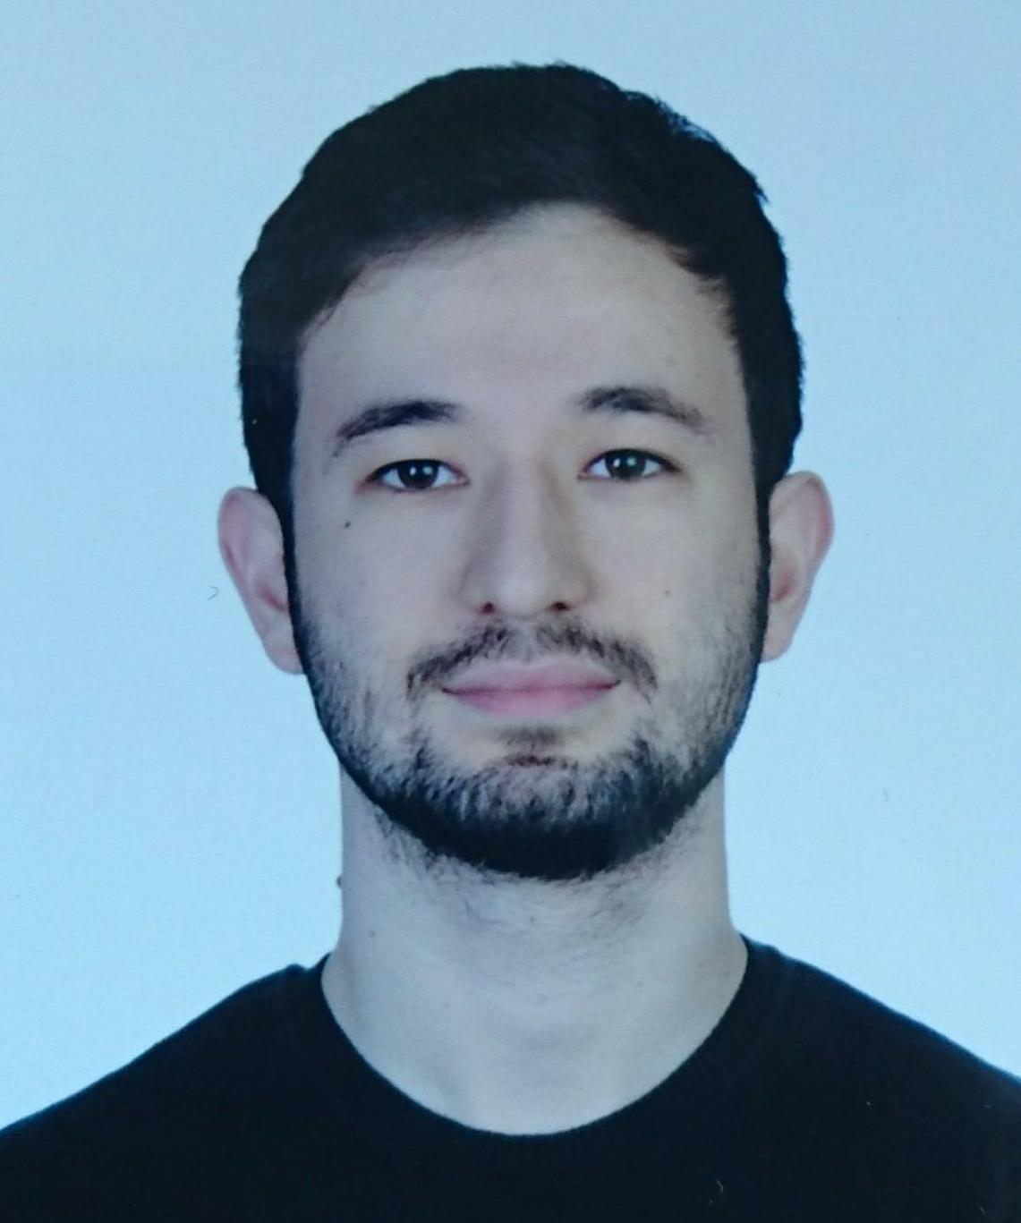
CFO AYCAN BEYENİR
PITECH

Slide 25
PITECH

Slide 26
PITECH

Slide 27
PITECH

Slide 28
PITECH

Slide 29
PITECH

Slide 30
PITECH

Slide 31
PITECH

Slide 32
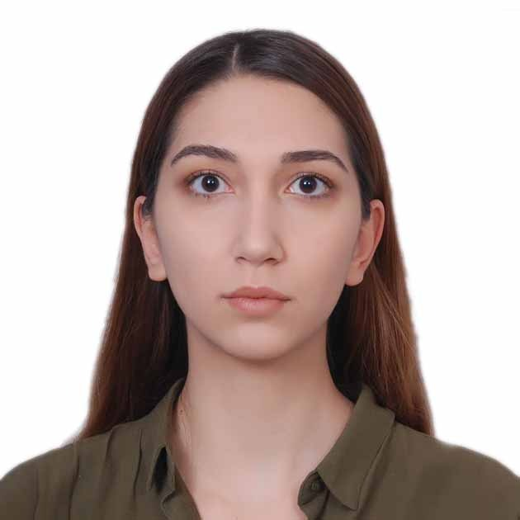
COO İREM COŞKUN
PITECH

Slide 33
PITECH

Slide 34
PITECH

Slide 35
PITECH

Slide 36
PITECH

Slide 37
PITECH

Slide 38
PITECH

Slide 39
PITECH

